Slide 1



IN ASSOCIATION WITH

Slide 2

Future of Mobility
2
HEY THERE!
I am Shaswata Saha and am going to give you a walkthrough of my data regarding the modal transportation. I have prepared a good UI and have sticked images to not make the learning process boring.
Lets start!!

Slide 3
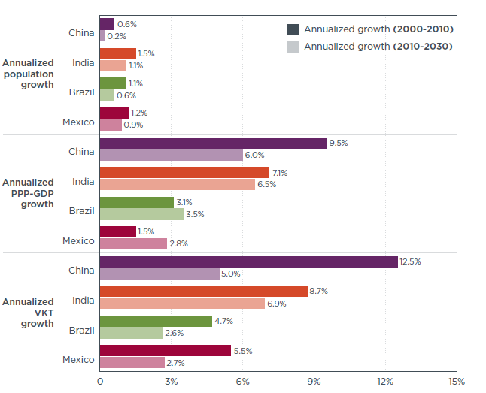
Problem Statement 1: Multi Modal Transporation
Multi-modal transportation in India is becoming increasingly important as the country's economy and infrastructure continue to grow. Multi-modal transportation refers to the use of multiple modes of transportation, such as roads, railways, waterways, and airways, in a single journey or shipment.
In India, the road network is the backbone of the transportation system, with over 5 million kilometers of roads, but it is often congested and not always reliable. Therefore, multi-modal transportation can help reduce congestion and improve efficiency.

Slide 4
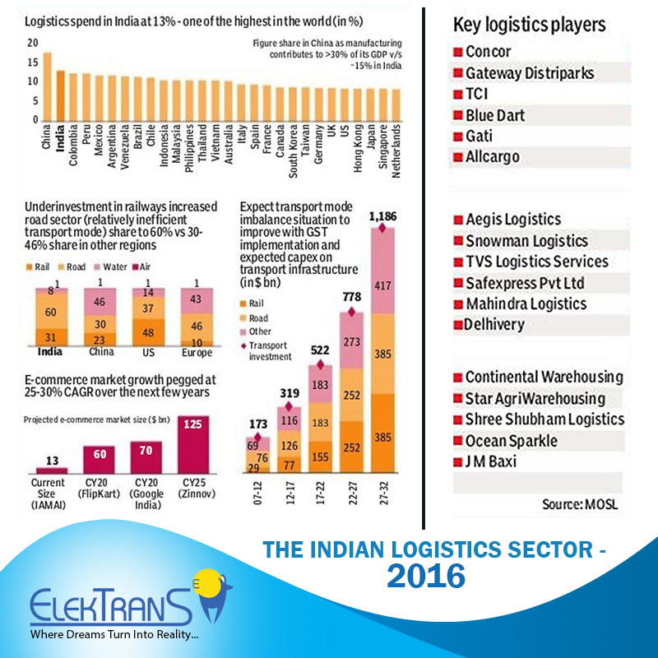
The government of India has recognized the importance of multi-modal transportation and has taken steps to promote it. For example, the Sagarmala project, launched in 2015, aims to develop a port-led development strategy and enhance the connectivity of ports with the hinterland through multi-modal transportation. The government is also developing the Dedicated Freight Corridor project, which will provide a dedicated railway line for freight transportation.
In addition, private companies are also investing in multi-modal transportation infrastructure. For example, the Adani Group is developing a multi-modal logistics park in Haryana, which will have connectivity to rail, road, and air transportation.
Overall, multi-modal transportation has the potential to significantly improve transportation efficiency and reduce costs in India. However, there are still challenges that need to be addressed, such as regulatory issues and infrastructure gaps, before it can be fully realized.

Slide 5
Actual Problems And Solutions
Multi-modal transport drift can occur when there is a lack of coordination between different modes of transportation, leading to delays, inefficiencies, and increased costs. To address this issue in India, here are some solutions that can be implemented:
Develop a national multi-modal transport policy: A comprehensive policy that outlines the goals and objectives of multi-modal transport can help to ensure that all modes of transportation are coordinated and integrated. The policy should include measures to improve connectivity, infrastructure, and information sharing among different modes of transport.
Implement technology solutions: The use of technology, such as GPS tracking and real-time data sharing, can help to improve communication and coordination between different modes of transportation. This can help to reduce delays and improve the efficiency of the transport system.

Slide 6
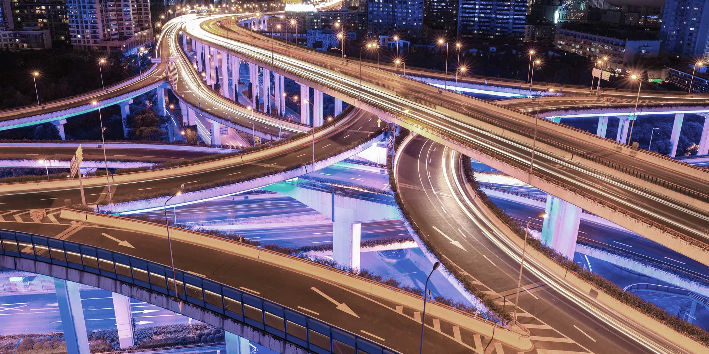
3. Streamline regulations: Regulations that govern different modes of transportation can often be complex and inconsistent. Streamlining regulations can help to ensure that all modes of transportation operate in a coordinated and efficient manner.
4. Promote public-private partnerships: Public-private partnerships can help to leverage private sector expertise and resources to improve the efficiency of the transport system. These partnerships can involve the development of new infrastructure or the use of technology to improve communication and coordination between different modes of transportation.
Improve infrastructure: Infrastructure improvements, such as the development of dedicated freight corridors and intermodal terminals, can help to facilitate the movement of goods and people between different modes of transportation. This can also help to reduce congestion and improve the efficiency of the transport system.

Slide 7
Problem Statement 2: Smart Batching
Smart batching is a concept that refers to the grouping of multiple shipments or orders into a single delivery or transportation vehicle, with the aim of reducing the number of trips needed to move goods. Smart batching can help to optimize the use of transportation resources, reduce transportation costs, and improve the efficiency of the transport system.
In the context of transportation, smart batching can involve grouping shipments based on their destination, timing, weight, or other factors. For example, a logistics company might use smart batching to group multiple orders from different customers into a single delivery truck, thereby reducing the number of trips needed to complete those orders.
Smart batching can also be used in conjunction with other technologies, such as GPS tracking and real-time data sharing, to optimize the routing of delivery vehicles and minimize the time and distance needed to move goods.
Overall, smart batching is a strategy that can help to improve the efficiency and sustainability of the transport system, while also reducing costs for both transport providers and customers.

Slide 8
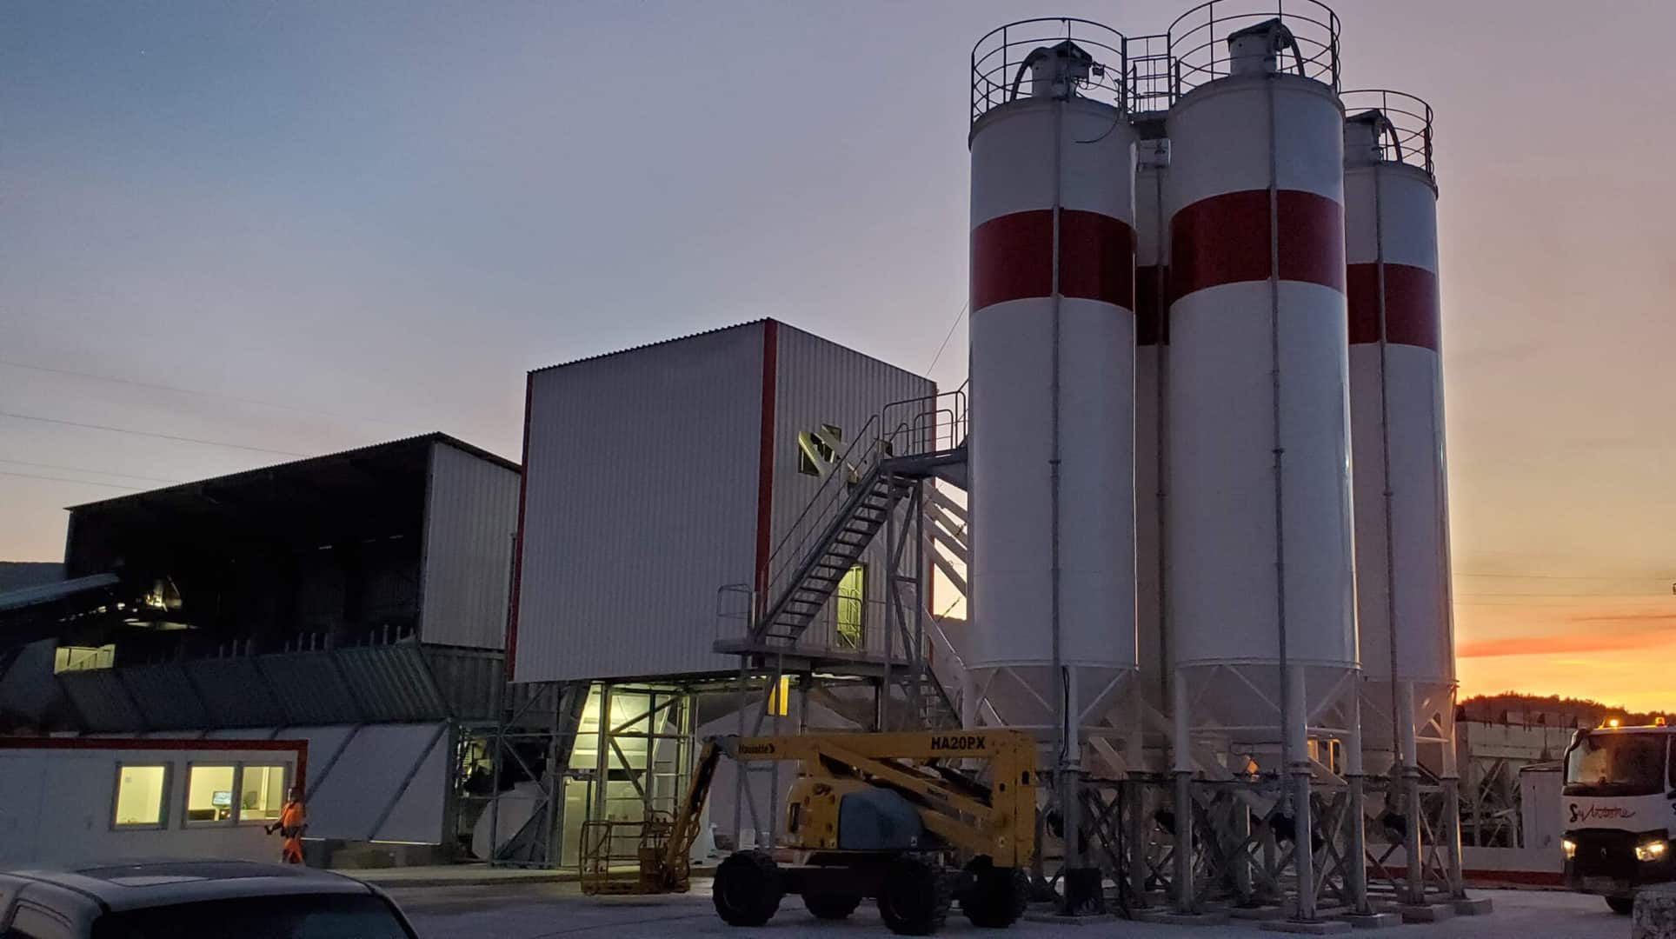
Smart Batching items

Slide 9
General Problems and Solutions
Although smart batching has several benefits for the transportation industry, there are some potential problems that can arise with its implementation. Here are some of the challenges that need to be addressed along with the potential solutions:
Complexity of logistics management: Smart batching can increase the complexity of logistics management, as it requires a high degree of coordination between different parties involved in the transportation process. This can be challenging, particularly for small or medium-sized logistics providers with limited resources.
Solution: Implementing advanced transportation management systems (TMS) that are specifically designed to manage smart batching can help streamline the logistics process. Using these systems can help automate many aspects of the process, thereby reducing complexity and the risk of errors. Additionally, offering training and support to logistics providers can help to ensure they have the necessary knowledge and skills to manage the smart batching process effectively.

Slide 10
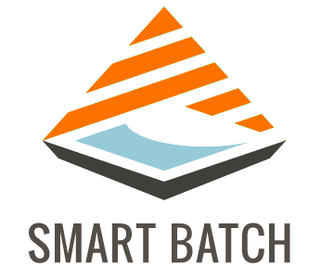
Higher upfront investment: Implementing smart batching technology requires a significant upfront investment in software, hardware, and infrastructure. This can be a barrier to adoption, particularly for smaller companies that may not have the resources to make such investments.
Solution: To address this problem, companies can consider partnering with technology providers that offer subscription-based or pay-per-use models. These models allow businesses to access smart batching technology without incurring significant upfront costs. Additionally, governments can offer tax incentives and other financial support to businesses to encourage them to invest in smart batching technology.
Potential for delays: Smart batching requires that shipments be grouped and delivered together, which can result in delays if one shipment is delayed.
Solution: To minimize the risk of delays, companies can implement real-time tracking and communication systems that provide updates on shipment status. This can help logistics providers to adjust delivery routes and schedules to avoid delays and ensure timely delivery. Additionally, by setting realistic expectations and providing customers with regular updates, companies can help to manage customer expectations and minimize dissatisfaction.
Overall, these solutions can help to address the challenges associated with implementing smart batching in transportation, thereby enabling companies to take advantage of the benefits of this technology.

Slide 11
Problem Statement 3: Bengaluru Open Issues
Bengaluru, like many other cities in India, faces several challenges in its modal transport system. Here are some of the issues faced by Bengaluru:
Traffic congestion: Bengaluru is known for its heavy traffic congestion, which causes significant delays and reduces the efficiency of the transport system. The city's roads are often clogged with private vehicles, buses, and other modes of transport, leading to long commute times and increased fuel consumption.
Lack of integration: Bengaluru's transport system lacks integration between different modes of transport, such as buses, trains, and metros. This makes it difficult for commuters to switch between different modes of transport and increases travel times.
Poor infrastructure: The city's transport infrastructure, including roads, bridges, and flyovers, is often inadequate to support the high volume of traffic. Additionally, many of the city's roads are in a state of disrepair, which can lead to accidents and increased travel times.

Slide 12
Inadequate public transport: While Bengaluru has a fairly extensive public transport network, it is often insufficient to meet the needs of the city's growing population. Buses are often overcrowded, and there are limited options for commuters traveling to and from the suburbs.
Lack of parking facilities: The city's limited parking facilities, particularly in busy areas, often lead to illegal parking and traffic congestion.
To address these issues, the government of Karnataka and Bengaluru's local administration have proposed several initiatives, such as:
Developing an integrated transport system: The government is working on integrating different modes of transport to make it easier for commuters to switch between them. This includes the development of an integrated ticketing system that allows commuters to use a single ticket to travel on multiple modes of transport.
Improving infrastructure: The government has proposed several infrastructure development projects, including the construction of new roads and bridges, to improve traffic flow and reduce travel times.

Slide 13
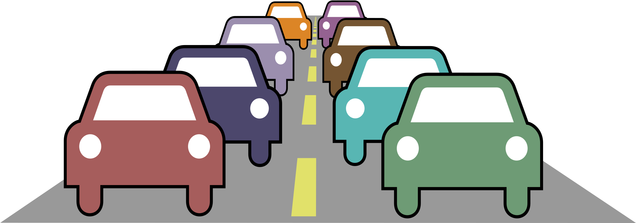
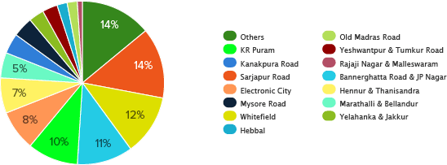
Expanding public transport: The government is working on expanding the city's public transport network, including the development of a new metro line and the addition of more buses to the fleet.
Promoting cycling: The government is promoting cycling as a means of transportation, with the development of cycling lanes and the introduction of bike-sharing schemes.
Overall, these initiatives are aimed at improving the efficiency and sustainability of Bengaluru's transport system and reducing traffic congestion in the city.

Slide 14
Conclusion
In conclusion, the transportation industry plays a critical role in the Indian economy, and it faces several challenges, such as traffic congestion, inadequate infrastructure, and lack of integration between different modes of transport. However, the implementation of smart batching and the adoption of new technologies such as IoT and AI can help to improve the efficiency and sustainability of the transportation industry. In addition, the development of an integrated transport system, expansion of public transport, and promotion of cycling can help to address some of the issues faced by cities like Bengaluru. Ultimately, the successful implementation of these initiatives requires collaboration between the government, the private sector, and the public to create a comprehensive, sustainable, and efficient transportation system that benefits all stakeholders.

Slide 15


Contacts
Email: shaswata.ssaha@gmail.com

